Slide 1
Teradata 2019 Data Challenge
HHUSA Unsolicited Donors
Joshua Chukwu
Afolarin Olayemi
Alex Montes de Oca

Slide 2
Summary
Problem & Motivation
Objective: provide recommendations and possible solutions for Hire Heroes USA
Research questions
What frequency do we see unsolicited (non-event or fundraiser) donors month to month?
What is the average gift of an unsolicited individual donor?
HHUSA’s needs to be able to raise money to survive
Funds are restricted based on how funds are obtained
Solicited: must pertain to specific need
Unsolicited: can be used in any area
Motivation → HHUSA can forecast unsolicited funds & decide how to allocate them in the future

Slide 3
Approach
Identify the frequency in which unsolicited donors contribute month to month
Identify the average and median of total donations made by each unsolicited individual donor
Issue → not all entries in SalesForces_Opportunity dataset were present in “SaleForces_Account” dataset
Solution →
Bar chart for amount of donors approached for donations (show frequency of unsolicited/solicited)
Bar chart for number of donors who donate monthly

Slide 4
Tools & Analytics
Determine which data is helpful
Describe, explore, & verify data
Microsoft Excel → selecting & cleaning data
Amount of donors approached for donations
Approached_for_donation_c
Deleted rows with empty values

Slide 5
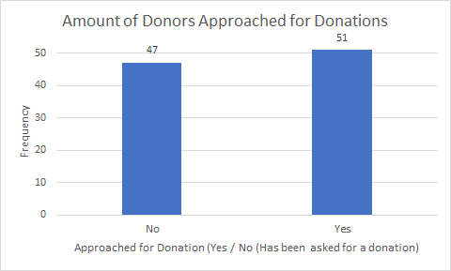
Existing Entries for Donors Approached for Donation

Slide 6
Tools & Analytics (cont.)
Number of donors who donate monthly
Monthly_Donation_c
Delete empty cells
COUNT formula → count entries containing “0” & ”1”

Slide 7
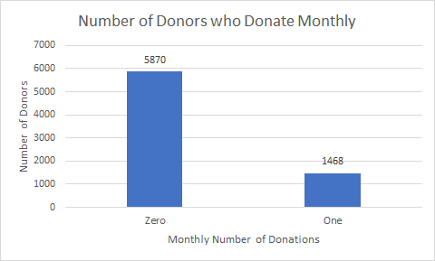
Donors that Donate Monthly

Slide 8
Tools & Analytics (cont.)
Mean & Median of Total Donations
stayclassy_donation_total_c
AVERAGE function
MEDIAN function

Slide 9
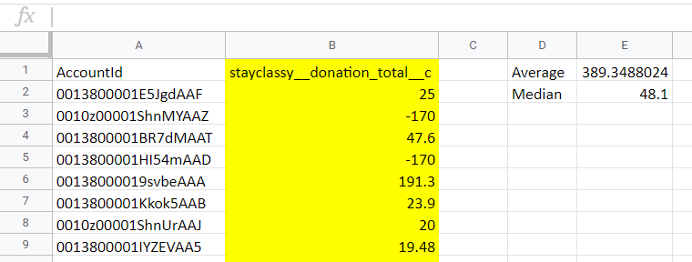
Mean & Median Amount of Total Donations of Donors

Slide 10
Solutions/ Recommendations
Utilized additional methods to solicit donations because the majority of unsolicited donors don’t donate monthly, however solicited donors so because they made a pledge
Creating a process to follow-up with and contact first-time unsolicited donors to thank them for their contribution, as well as convince them to commit to a monthly pledge.

